Slide 1
Photo Credit: City of Hayward Twitter
General Plan Amendments:
LOS to VMT
GHG Goals
City of Hayward
City Council
June 16, 2020

Slide 2
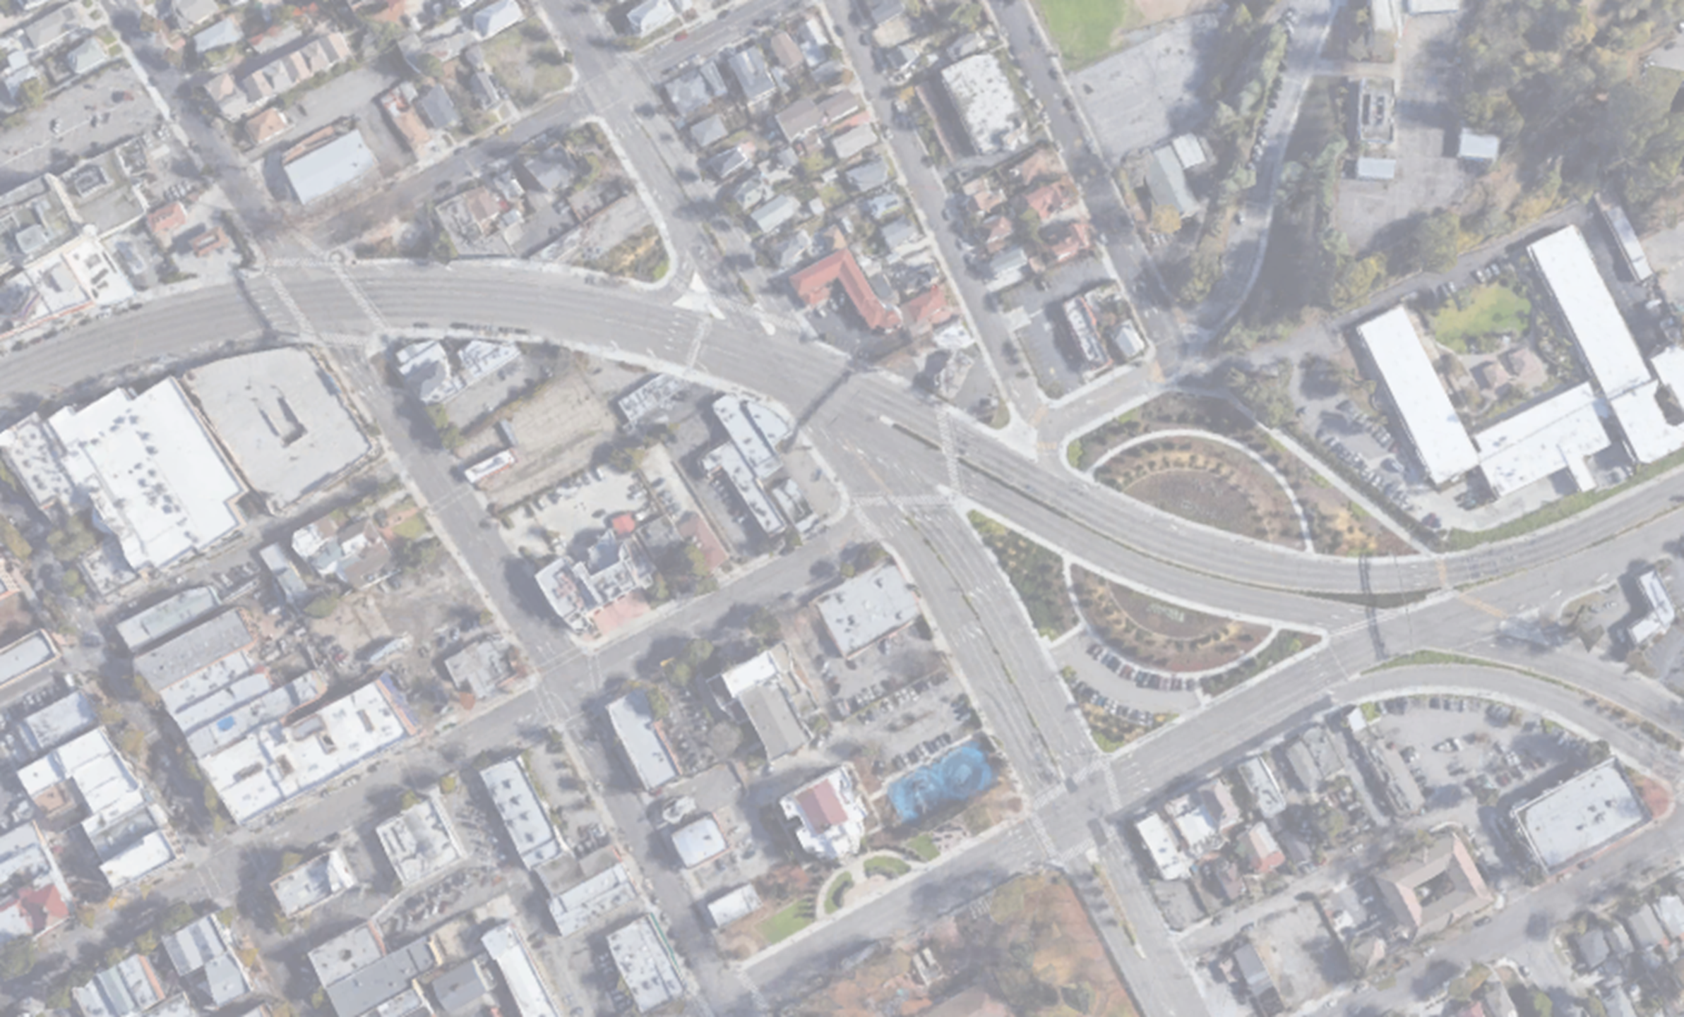
Greenhouse gas emission reduction goals
SENATE BILL 743: LOS TO VMT

Slide 3
INTRODUCTION TO SENATE BILL 743 (SB 743)
What is SB 743?
Prohibits use of LOS as a CEQA threshold of significance
Why SB 743?
VMT is the most appropriate metric for measuring impact of transportation on the environment
How to comply to SB 743?
Prepare and adopt General Plan Amendments for location- and project-based analysis
When to comply to SB 743?
By July 1, 2020

Slide 4
LOCATION-BASED exemptions
LAND USE | THRESHOLD | PRECEDENT
Residential | 15% below existing average VMT per capita | OPR
Residential (Affordable Housing) | Below existing average VMT per capita | OPR
Employment (Office) | 15% below existing average VMT per employee | OPR
Employment (Industrial) | Below existing average VMT per employee | San José

Slide 5
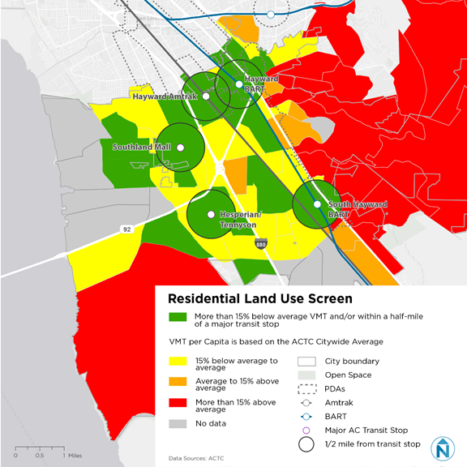
Residential screen map
Location-based
Residential Thresholds (VMT per Capita)
Under 15% below average | < 17.93
Under average | 17.94 - 21.09
Average | 21.10
Over average | 21.11 - 24.26
Over 15% above average | > 24.26

Slide 6
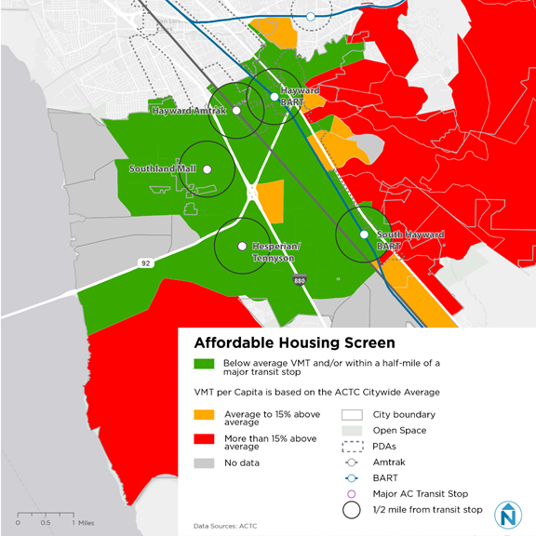
Affordable housing screen map
Location-based
Affordable Housing Thresholds (VMT per Capita)
Average | 21.10
Over average | 21.11 - 24.26
Over 15% above average | > 24.26

Slide 7
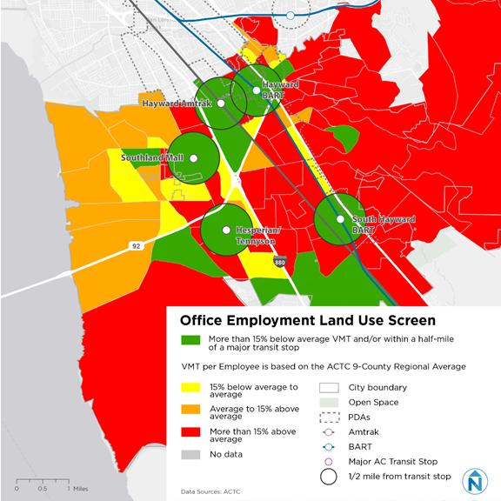
office screen map
Location-based
Employment Thresholds (VMT per Employee)
Under 15% below average | < 13.47
Under average | 13.47 - 15.84
Average | 15.85
Over average | 15.86 - 18.23
Over 15% above average | > 18.23

Slide 8
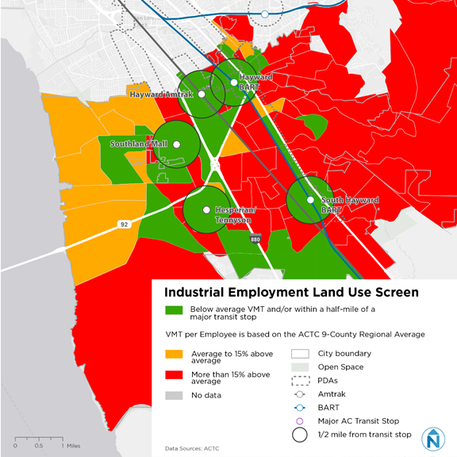
industrial screen map
thresholds
Industrial Thresholds (VMT per Employee)
Average | 15.85
Over average | 15.86 - 18.23
Over 15% above average | > 18.23

Slide 9
project-based exemptions
LAND USE |  | CRITERIA
Residential | Detached Units | < 15 units
 | Attached Units | < 25 units
Employment | Office | < 10,000 gross square feet
 | Local-Serving Retail | < 50,000 gross square feet

Slide 10
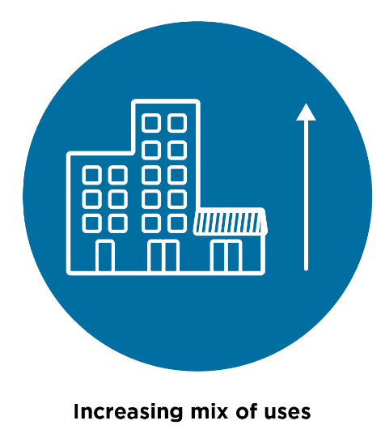
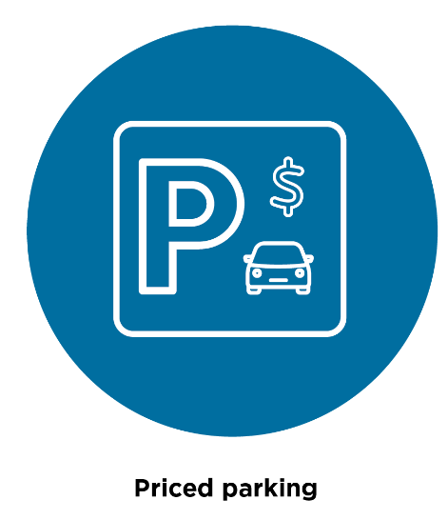
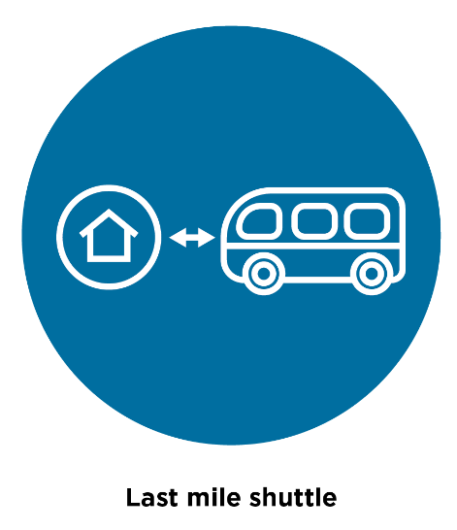
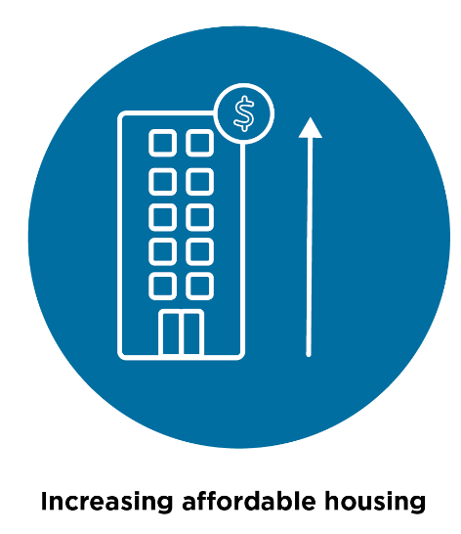
Transportation demand management (Tdm)
Increasing Mix of Uses
Improving Multimodal Network
Transit Passes or other Incentives
Priced
Parking
Last Mile
Shuttle
Transit
Improvements
Increased Affordable Housing
Commute Trip Reduction Program

Slide 11
Greenhouse gas emission reduction goals
Notes:
And now for the 2nd recommended GPA…
Greenhouse Gas Emission Reduction Goals …new proposed goals as recommended by Planning Commission and Sustainability Committee
Also, actions that will be necessary to meet the goals…

Slide 12
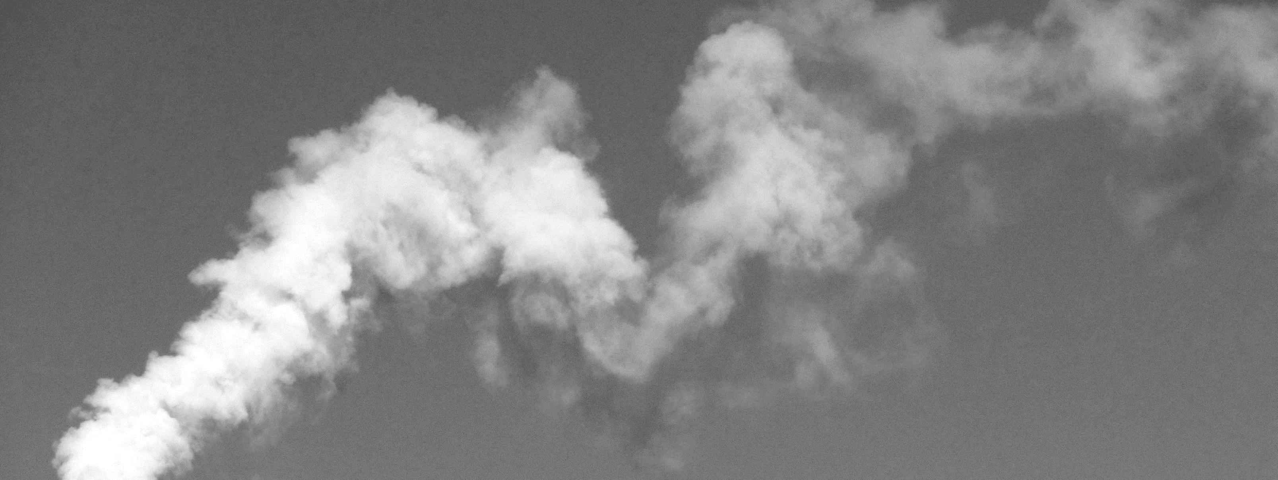
Hayward’s Current GHG Emission Reduction Goals
20% below 2005 levels by 2020
61.7% below 2005 levels by 2040
82.5% below 2005 levels by 2050
Notes:
Hayward first outlined GHG emission reduction targets in 2009 in our original Climate Action Plan.
Since then, we incorporated the CAP into the General Plan in 2014, where we slightly adjusted the goals and added a 2040 goal.
Odd numbers are due to calcs… match state’s goals
These goals are included as policies NR______and NR______
…..to reduce emissions by 20% below 2005 baseline levels by 2020; strive to reduce emissions by 61.7% by 2040; and strive to reduce emissions by 82.5% by 2050.
Currently no goal for 2030

Slide 13
California’s GHG Emission Reduction Goals
AB 32: Reduce GHG emissions to 1990 levels by 2020
EO #S-03-05: 80% reduction by 2050
SB 32: Reduce GHG emissions to 40% below 1990 levels by 2030
EO #B-55-18: Carbon neutrality by 2045
Notes:
Current goals (adopted in 2014 General Plan) mirror those identified in California state legislature, such as the California Global Warming Solutions Act of 2006 (AB-32) and the Governor’s Executive Order #S-03-05.
In September 2016, SB 32 was signed into law.
In September 2018, Governor Brown signed the Executive Order that committed California to economy-wide carbon neutrality by 2045.
In light of this new goal, staff looked to incorporate a 2045 carbon neutrality goal and set some interim goals to help create a pathway to 2045 carbon neutrality.

Slide 14
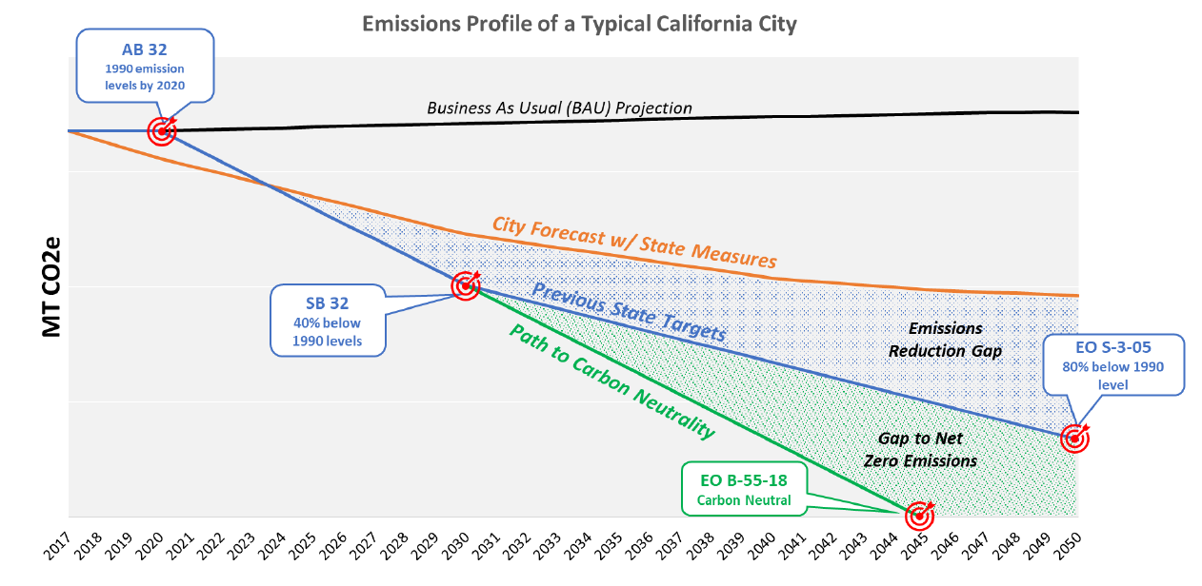
GHG Emission Reduction Pathways
Notes:
To visual what those bills and executive orders, we have this graph.
Our starting point in the left hand corner is our 2020 goal. The black lines shows Business as Usual. Below that you can see the orange line, which is showing a reduction based on some state measures that are causing reductions (RPS, vehicle efficiency, etc.)
Next, you can see the SB 32 target.
SB32 requires the state to reduce emissions 40% below 1990 levels.
Since Hayward uses a different baseline year, the equivalent is roughly 55% below 2005 levels by 2030.
From there, the blue trend line shows us meeting the EO that committed to 80% reduction.
And then below that, you see the green line showing the path to carbon neutrality based on the most recent executive order.

Slide 15
GHG Goals throughout Alameda County
 | Baseline Year | 2020 Target | 2030 Target | 2040 Target | 2045 Target | 2050 Target
Alameda | 2005 | 25% | 40% |  |  | 80%
Albany | 2004 | 25% | 60% |  | 100%
Berkeley | 2000 | 33% |  |  |  | 80%
Dublin | 2010 | 15% | 40% |  |  | 80%
Emeryville | 2004 | 25% | 40% |  |  | 100%
Fremont | 2005 | 25% | 55% |  | 100%
Hayward (existing) | 2005 | 20% | - | 61.7% | - | 82.5%
Hayward (proposed) | 2005 | 20% | 55% |  | 100%
Livermore | 2008 | 15% | 60%
Newark | 2005 | 15%
Oakland | 2005 | 36% | 56% |  |  | 83%
Piedmont | 2005 | 15% | 40%
Pleasanton | 2005 | 15% | 40%
San Leandro | 2005 | 25% | 40%
Union City | 2005 | 20%
Notes:
most cities in Alameda County have adopted 2030 targets of at least 40% below baseline and some have adopted or are considering 2045 carbon neutrality goals – like Albany and Fremont
Fremont adopted carbon neutrality in _____ and is currently updating CAP
Other cities in bay area…. Mountain view adopted carbon neutrality in _____

Slide 16
Recommended GHG Emission Reduction Goals
30% below 2005 levels by 2025
55% below 2005 levels by 2030
Work with the community to develop a plan that may result in the reduction of community-based GHG emissions to achieve carbon neutrality by 2045
Notes:
Recommended by PC and CSC…
Exact text is in attachment _______
These goals are ambitious and will be difficult to meet. And we don’t currently know how exactly we will meet these goals.
Prior to the Planning Commission meeting, staff consulted with an environmental consulting firm regarding the proposed GHG emission reduction goals and how they may affect the City’s review of planning applications in regard to compliance with the California Environmental Quality Act (CEQA). Considering the City’s use of 2005 as the baseline year, it was determined that Hayward’s 2030 goal should be 55% to be consistent with SB 32.5 Having a local goal that is not as stringent as state law can complicate the analysis of development applications. Staff also found that a carbon neutrality goal, if adopted as policy in the City’s General Plan, could be very difficult for developers to provide emissions analyses showing that projects will be consistent with the General Plan.
Staff presented this information to the Planning Commission on December 12, 2019,6 and the Planning Commission voted unanimously to recommend that Council amend the General Plan to include the following GHG emission reduction goals:
30% below 2005 levels by 2025
55% below 2005 levels by 2030
work with the community to develop a plan that may result in the reduction of community-based GHG emissions to achieve carbon neutrality by 2045

Slide 17
Hayward's GHG Emissions (2017)
Notes:
take a step back and look at our GHG emission inventory data and provide some insight on feasibility.
Our largest source of emissions is from transportation at 60% and if you combine that with off-road vehicles and BART, it is 68%.
Our second largest source of emissions is energy.
So to make significant GHG reductions and reach carbon neutrality, we will need to address our energy and transportation emission sources.

Slide 18
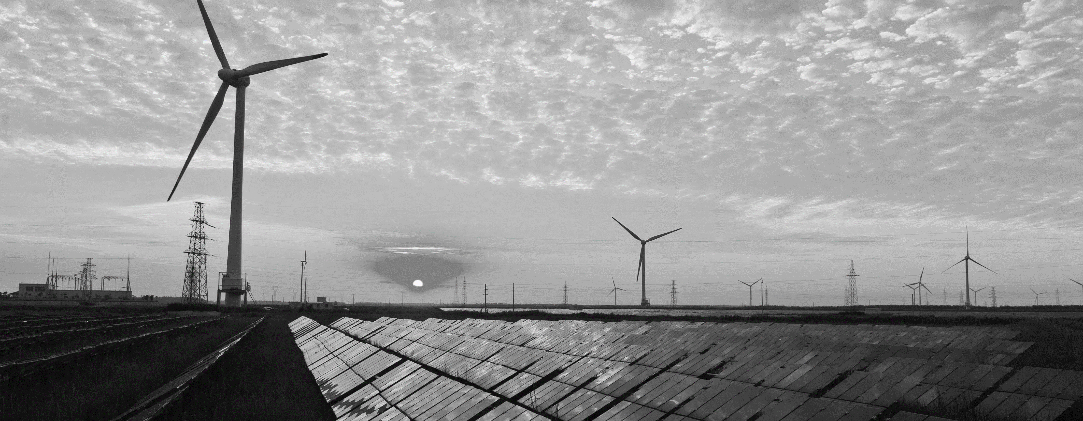
Ways to Achieve New 2030 Goals
Electricity | 100% carbon-free electricity
Natural Gas | Retrofit 32,000 existing homes to all-electric
Transportation | Replace 61,700 gasoline vehicles replaced with electric vehicles
Notes:
Electricity
To meet the proposed 2025 and 2030 goals, all of EBCE’s electricity products will need to be 100% carbon-free by 2030 and we have a very small opt-out rate for both residential and commercial customers.
To meet the proposed 2025 goal, 78% of Hayward customers would need to receive 100% carbon free electricity.
By 2030, at least 93% of Hayward customers would need to receive 100% carbon free electricity.
rate for carbon-free electricity (Brilliant 100) is currently equal to PG&E rates,
however as noted above, the EBCE Board may soon be considering an increase in the rate for
Brilliant 100, which may affect Hayward’s ability to meet its 2020 goal.
Going to discuss B100 rate in July work session
Natural Gas
In order to meet the 2025, 15% of residential homes (approximated 7,500 dwelling units) would need to be retrofitted to all-electric.
As you can see on this slide I have both the 50% by 2030 target and 55% target. While 5% may not seem like a large percentage, it does require significant increase in what needs to happen to achieve the goal.
So a 50% goal would require just over 20,000 existing homes would need to be retrofitted to all-electric.
Or a 55% Goal would require over 32,000 existing homes to be retrofitted.
The City of Palo Alto commissioned a study that estimates retrofitting a single-family home to an all-electric package will cost the customer $6,891 more than natural gas over 30 years (around $5,000 in up-front costs and just under $2,000 in higher energy costs).
There are still no electrification rebates available to Hayward customers. BayREN, PG&E, and EBCE do all have rebates in the works and hoping to release them soon.
The City will need to make it a priority that low-income households are not left behind as we transition away from natural gas. And there are new studies and guidelines coming out on an equitable transition that the City can use as a resource.
Hayward has seen a slow decline in residential natural gas emissions,
but nonresidential natural gas use has been increasing. In order to meet the 2025 goal, if
nonresidential natural gas use remains constant, 20% of residential homes (approximately
10,000 dwelling units) would need to be retrofitted to all-electric. For 2030, nonresidential
natural gas use would need to decrease significantly and an additional 45% of residential
homes (an additional 22,000 dwelling units) would need to be retrofitted to all-electric.
With current resources available to residents, this will be very challenging to achieve.
Transportation
Hayward has seen a small decline in transportation emissions from 2005 to 2017. However, this reduction in emissions should most likely be credited to increased vehicle efficiency, as our vehicle miles traveled have increased since 2010.
Assuming the continuation of increased vehicle efficiency and that passenger vehicles remain the prominent mode of transportation, over 61,000 gasoline vehicles will need to be replaced with an electric vehicle by 2030.
There are programs that staff can promote, like the Air District’s Clean Cars for All program, which offers significant rebates to low income households that replace older cars with EVs. Staff also hosted two electric vehicle workshops these past two Saturdays, one in English and one in Spanish. Bringing together different community partners to educate the community on what their options are and how they can take advantage of the different rebate programs available.
In general, more incentives will need to be made as EV ownership is not increasing at the rate we need to be carbon neutral in 2045. With transportation accounting for an overwhelming amount of Hayward’s emissions, it is not a source we can ignore and expect to meet aggressive GHG emission reduction targets.
Hayward has seen a small decline in transportation emissions from
2005 to 2015. However, this reduction in emissions should be credited to increased vehicle
efficiency as the vehicle miles traveled (VMT) have increased since 2010 as the economy
recovered from the Great Recession. Meeting the 2025 and 2030 goals will rely on the City
drastically reducing transportation related emissions, which accounted for 59% of
Hayward’s total emissions in 2017. Assuming the continuation of increased vehicle
efficiency and that passenger vehicles and light trucks remain the prominent mode of
transportation, 15% (around 21,000 vehicles) of the gasoline fleet would need to be
replaced with electric vehicles (EVs) by 2025 and 45% (an additional 40,700 vehicles) by
2030. While very challenging, these goals can be helped with the fact that many automobile
manufacturers are transitioning to production of all-electric vehicles with some planning to
stop manufacturing gas-powered passenger vehicles.
Staff recognizes that reductions in vehicle-related emissions will be difficult. As reported by
the Mercury News on October 9, 2019 (see Attached), California is projected to fail to meet
is emissions targets – partially because “Californians aren’t ready to give up their trucks
and SUVs.” While EV ownership is increasing, more incentives will need to be made
available statewide. In addition, staff can promote existing local programs such as the Air
District’s Clean Cars for All4 program, which offers significant rebates to lower income
households that replace older cars with EVs.

Slide 19
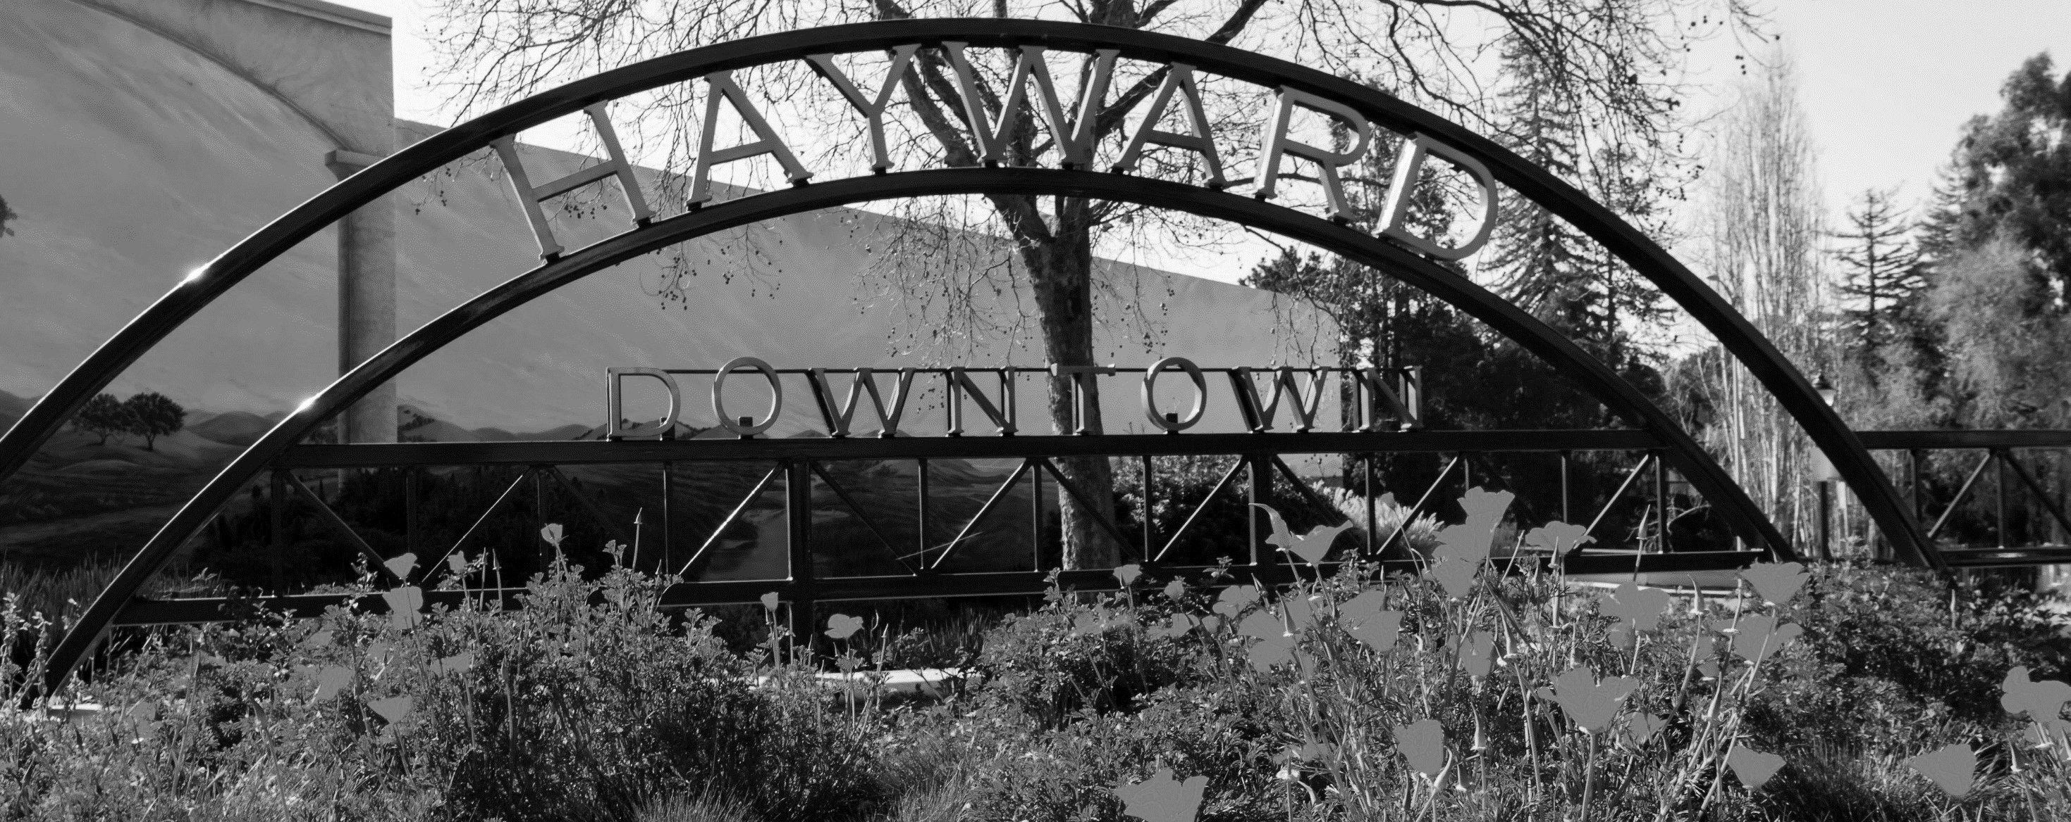
Planning - Environmental Review
Projects subject to CEQA are required to include GHG analysis showing project consistent with SB 32 and General Plan policies
Development projects can streamline their GHG analysis by tiering from an updated CAP
Notes:
these goals – as GP policies – must be addressed during review of development proposals
Main reason why we not saying “100%” for 2045
CEQA requires that GHG………..
All projects subject to CEQA are required to include a GHG analysis showing the project will be consistent with SB 32.
Following the Planning Commission hearing, staff continued to research the CEQA implications of adopting more stringent GHG reduction goals and how development projects will be evaluated in light of the new General Plan policies. Once the City has updated and adopted a 2030 Climate Action Plan (CAP), development projects will be able to streamline their GHG emission analysis by tiering from the CAP’s CEQA document. However, until the 2030 CAP is adopted, developers may be required to prepare an analysis without the benefit of guidance or a methodology that is specific to Hayward.

Slide 20
ENVIRONMENTAL REVIEW
VMT Thresholds
The proposed Amendment is exempt from CEQA because it does not constitute a “project” and because there is no potential that it will result in a direct or reasonably foreseeable indirect physical change in the environment.
GHG Reduction Goals
The proposed Amendment is exempt from CEQA because it is a regulatory action for the protection of the environment.

Slide 21
recommendation
That the City Council:
Adopts a resolution with amendments to the Hayward 2040 General Plan establishing new Vehicle Miles Traveled (VMT) thresholds for CEQA analysis, consistent with SB 743; and
Adopts a resolution with amendments to the Hayward 2040 General Plan establishing the adoption of new Greenhouse Gas Emission reduction goals for the City; and
Introduce an ordinance to amend the Hayward 2040 General Plan per the adopted resolutions.

Slide 22
Questions?

Slide 23
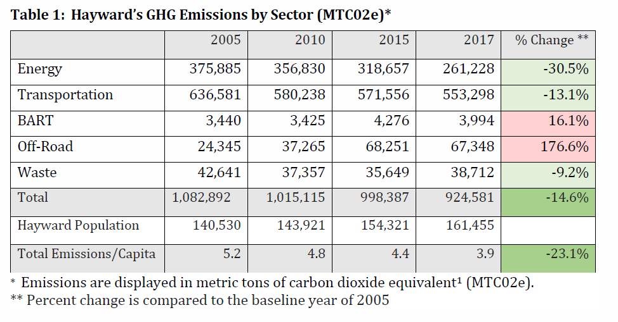
Hayward's GHG Emissions Reductions (2005 - 2017)
Notes:
look at our GHG emission inventory data and provide some insight on feasibility.
2017 GHG emission inventory are have a 14.6% reduction, and are on the pathway to meet 20% by 2020.
.

Slide 24
PROPOSED FINDINGS
Required findings for all text amendments to the General Plan per HMC Section 10-1.3425(a):
Substantial proof exists that the proposed changes will promote the public health, safety, convenience, and general welfare of the residents of Hayward;
The proposed changes are conformance with all applicable, officially adopted policies and plans;
Streets and public facilities existing or proposed are adequate to serve all uses permitted when the property is reclassified; and
All uses permitted when property is reclassified will be compatible with present and potential future uses, and, further, a beneficial effect will be achieved which is not obtainable under existing regulations
Notes:
General Plan and Climate Action Plan include adopted goals and policies that support the proposed GPA for a reduction of GHG emissions and adoption of new VMT thresholds.

Slide 25
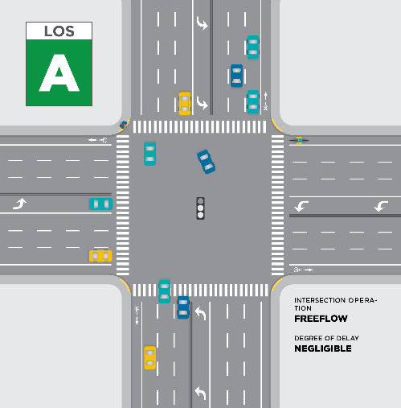
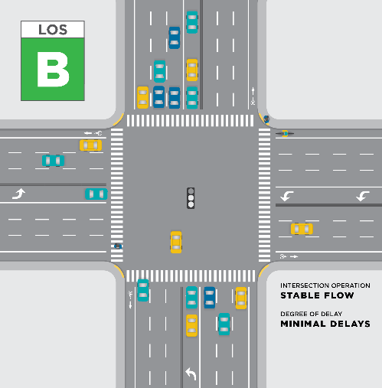
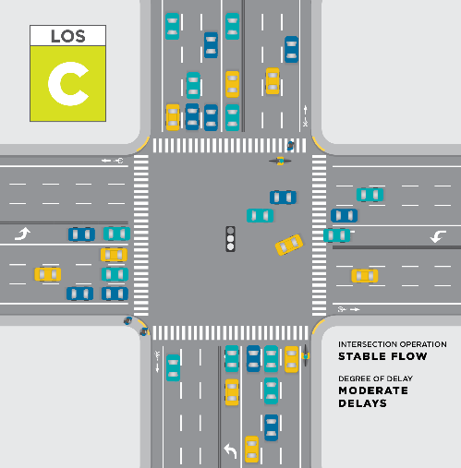
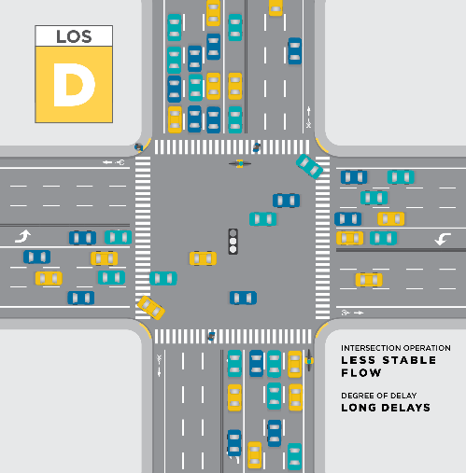
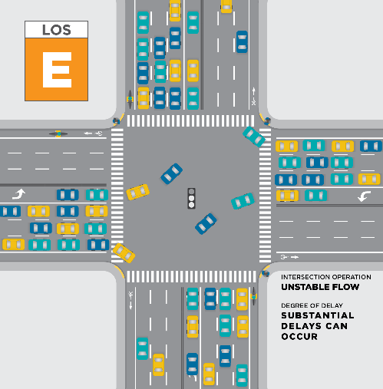
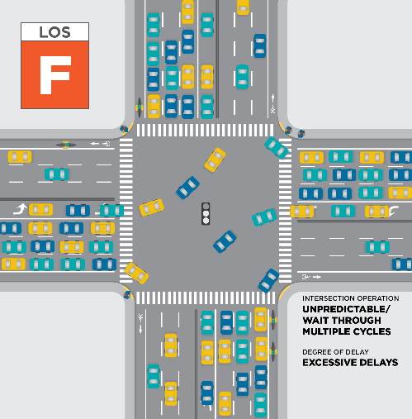
Local transportation
analysis (LTA)
City will continue to use its Traffic Study Guidelines posted online for the use of Level of Service (LOS) for Local Transportation Analyses (LTA)
Traffic impact fee (tif)
One-time fees typically paid prior to the issuance of a building permit and imposed on development projects
Anticipated to be presented to Council in Fall 2020
Notes:
And now for the 2nd recommended GPA…
Greenhouse Gas Emission Reduction Goals …new proposed goals as recommended by Planning Commission and Sustainability Committee
Also, actions that will be necessary to meet the goals…

Slide 26
process review
TRANSPORTATION STUDIES
 | CEQA | LTA | TIF
WHAT | VMT | LOS | FINANCIAL
WHEN | MAP OR SCREENS | TRIP GENERATION | ALL DEVELOPMENTS
HOW | VMT REDUCTION CALCULATOR | TRAFFIC IMPACT ANALYSIS | FEE TABLE
Notes:
And now for the 2nd recommended GPA…
Greenhouse Gas Emission Reduction Goals …new proposed goals as recommended by Planning Commission and Sustainability Committee
Also, actions that will be necessary to meet the goals…

Slide 27
Measuring Transportation: Vehicle Miles Traveled
Vehicle miles traveled (VMT): measures the total amount of driving over a given area
Based on geographic travel patterns, which reflect transportation infrastructure, transit service, and land use
Better connects environmental impact measurement to State greenhouse gas emissions reduction goals
Notes:
Existing can be City or Regional for residential and regional for employment. The 15% reduction is based on long range GHG emissions reductions goals for the State.

