Slide 1
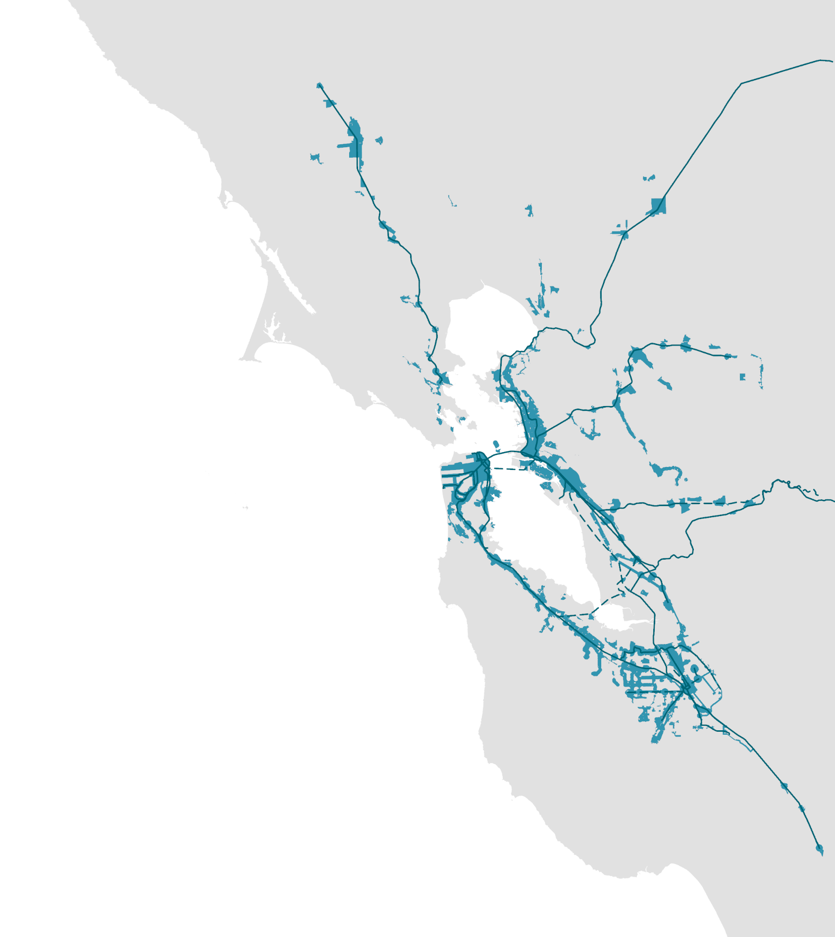
Briefing: Priority Development Area (PDA) Grant Application

Slide 2
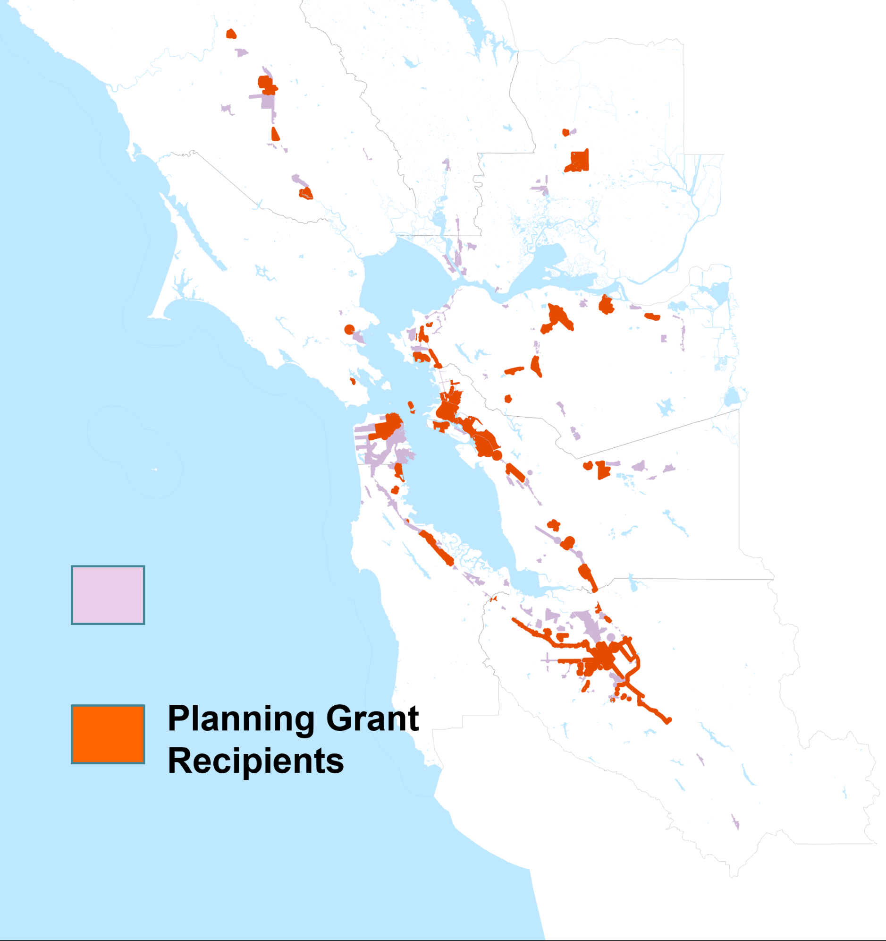
MTC Priority Development Area (PDA) Program
Santa
Rosa
Grant funding to complete and implement plans for locally-nominated Priority Development Areas
80+ plans funded to date across the Bay Area
Three types of funding:
Planning Grants (up to $1.2M)
Plan Amendments (up to $600K)
Plan Implementation (up to $200K)
Grant funding augmented by regional staff and consultant expertise
Fairfield
San
Rafael
Richmond
Antioch
Walnut
Creek
San
Francisco
Oakland
Livermore
San
Mateo
Fremont
PDAs
Mountain View
San
Jose
Gilroy

Slide 3
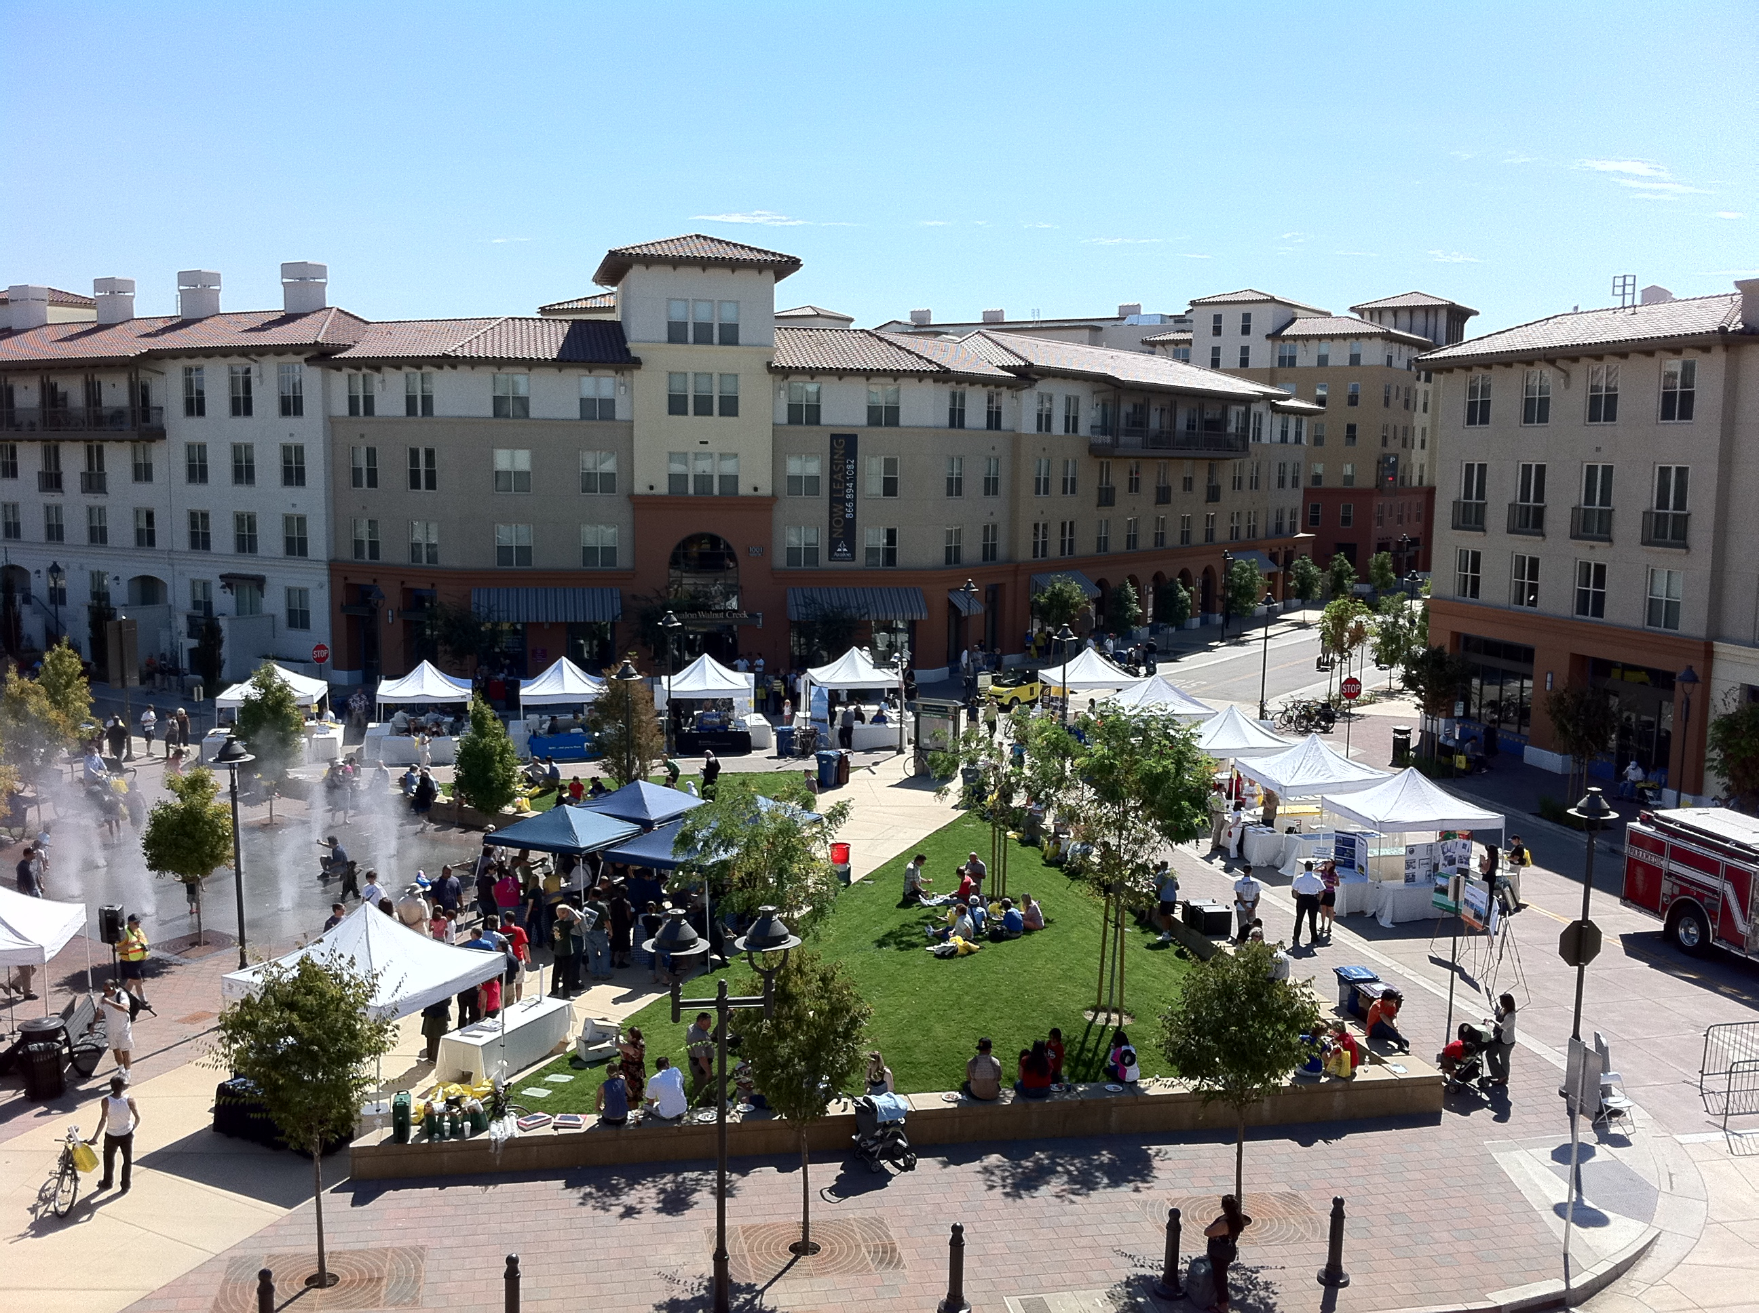
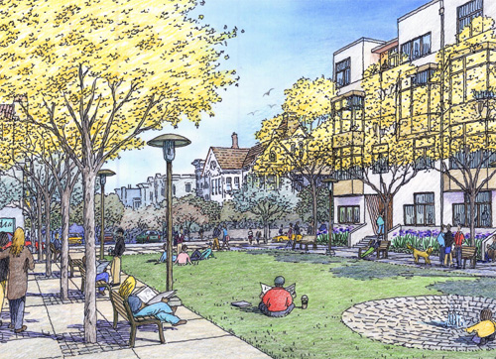
PDA Grants: Program Priorities
Priorities
Increase production, preservation, and protection of affordable and mixed-income housing
Reduce vehicle miles travelled by maximizing transit, walk, and bicycle trips
Create streets that are safe for everyone and expand transportation options

Slide 4
PDA Grants: Requirements
Requirements
Minimum expectation for plans: Development & Public Realm Standards; Capital Improvements list and funding strategy; Zoning & General Plan amendments; Equity policies; Community engagement
Commitment to meeting applicable state and regional policies, such as MTC’s Transit-Oriented Communities Policy.
Evidence of local support: Council Resolution and/or Briefing

Slide 5
[Insert Jurisdiction Name]’s PDAs
[Optional: insert slide(s) that lists/describes the jurisdiction’s PDA(s)]

Slide 6
[Insert PDA Name] Grant Proposal
Insert slide(s) that describe the jurisdiction’s grant proposal, potentially including:
PDA(s) targeted
Type of planning process (Complete Plan, Plan Amendment, Plan Implementation
Amount requested
Goals/expected outcomes
How proposal will meet minimum requirements (including MTC’s TOC Policy, if applicable)

Slide 7
Key Dates
December 2, 2022: MTC released Call for Projects
February 12, 2023: Applications due
May 2023: Awards announced (anticipated)
November 2023: Last date to launch grant-funded projects

