Slide 1
Updates on the Bay Area Housing Finance Authority
BAHFA Presentation to Elected Officials
September 30, 2026

Slide 2
Why Are We Here?
To gather input around a Policy Framework to guide possible amendments to BAHFA’s statute, and a potential regional revenue measure, as early as 2028.

Slide 3



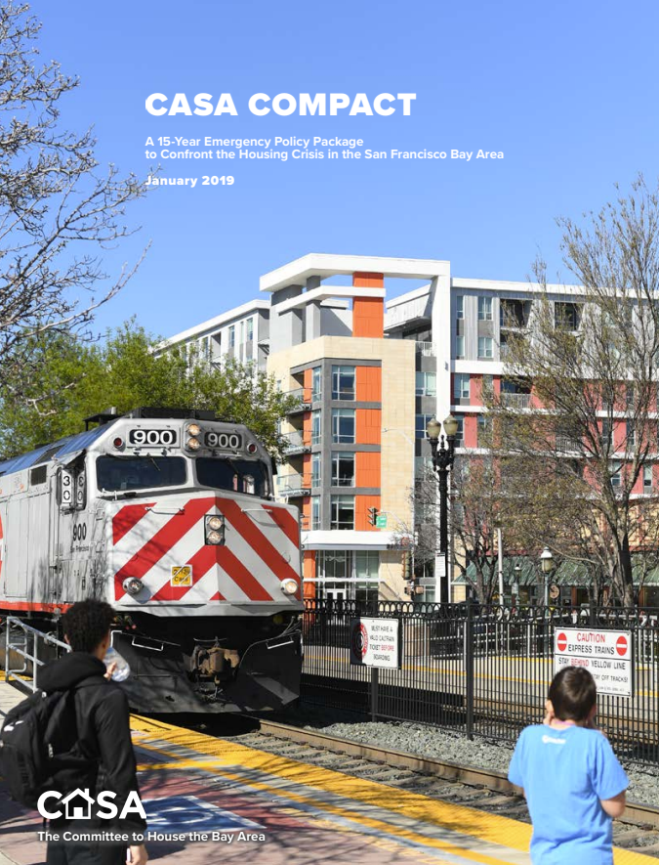
How We Got Here
WE ARE HERE
BAHFA 2019
Pilot Programs
RM4 Bond Measure 2024
(withdrawn)
Gathering Stakeholder Input
CASA Compact

Slide 4
How BAHFA Adds Value in Communities
The loss of redevelopment agencies has led to a reduction in real estate development and housing finance capacity at the local level.
62% of Bay Area communities do not directly receive federal funding for housing.
Most cities have extremely limited dedicated funds for affordable housing, and Bay Area counties are among the most expensive in the state.
A regional revenue measure would bring significant funding to be programmed at the local level.
Source: Terner Center for Housing Innovation
BAHFA brings housing funds and expertise to your communities, filling the gap in state and federal funds.

Slide 5
BAHFA's Impact to Date
500,000+
Doorway user accounts; over 3,200 placements
27,000+
New homes supported; direct funding to 1,365 affordable homes
3:1
Leverage of $20M state grant
1,000+
Homes preserved as affordable
124
Seniors prevented from falling into homelessness

Slide 6


Regional Revenue Measure Timeline
Phase 1: Stakeholder Engagement
Broad table to discuss outstanding policy issues to inform proposed legislative changes
BAHFA coordinates with stakeholders, building trust and generating buy-in
Outcome: policy framework for statutory amendments
Timing: ~March-Nov 2026
Phase 2: Legislative Changes
Implement policy framework through proposed amendments to BAHFA’s enabling legislation
Joint advocacy between BAHFA and coalition that could emerge from stakeholder process
Outcome: amended statute
Timing: Nov 2026-Sept 2027
Phase 3: Revenue Measure
Policy development of a regional measure, guided by revised statute
Potential for amended statute to permit placement via qualified voter initiative
If a measure proceeds, BAHFA role limited to public information; not involved in campaign activity
Outcome: ballot measure
Timing: Fall 2027-Nov 2028

Slide 7
Regional Housing Stakeholder Committee
RHSC Co-Chairs
Regional Housing Stakeholder Committee
Drive towards policy alignment using gradients of agreement
Coordinating Committee
Co-Chairs:
BAHFA
All Home
Enterprise
Consultant Support
Revenue Mechanisms Subcommittee
Eligible Uses of Revenue Subcommittee
Labor Subcommittee
Caucusing with broader
stakeholder groups

Slide 8
Key Policy Issues
BAHFA was created by a state statute that defines the types of revenue BAHFA can raise and eligible expenses. Key issues under consideration are:
Revenue Mechanisms
Eligible Uses of Funds
Labor Standards
Revenue Distribution

Slide 9
 | Legislative Details | Potential Action
GO Bond | Already allowed in BAHFA statute. | None
Uniform Parcel Tax | Already allowed in BAHFA statute. | None
Head Tax | Already allowed in BAHFA statute, with exemptions for nonprofit and religious institution employers. | None
Gross Receipts Tax | Already allowed in BAHFA statute, including potential design features identified by the subcommittee: Variable rates based on sector Exemptions for small businesses, nonprofits, & religious institution employers | None
Differentiated Parcel Tax | Would require the following amendments to BAHFA’s statute: Remove uniformity clause (allows for differentiation) Specify general ability to create exemptions | [1] Consider amendments to BAHFA statute.
Sales Tax | Would require: Adding sales tax as eligible mechanism to BAHFA’s statute Separate legislation to raise the local sales tax cap, which would require identifying specific sales tax rate by early-mid-2027. | [2] Consider amendments to BAHFA statute and companion legislation.
Payroll Tax | Would require adding payroll tax as eligible mechanism to BAHFA’s statute with specifics on exemptions and/or differentiation. | [3] Consider amendments to BAHFA statute.
Real Estate Transfer Tax | Would require adding RETT as eligible mechanism to BAHFA’s statute with specifics on design. | [4] Consider amendments to BAHFA statute.

Slide 10
BAHFA Statute’s Current Eligible Uses
Affordable Housing Production: at least 52%
Affordable Housing Preservation: at least 15%
Tenant Protections: at least 5%
Flexible Uses (any of 3Ps): 28% Locals / 18% Regional
Other Housing-Related Uses (Grant Program): 10% Regional

Slide 11
Emerging Potential Eligible Use Ideas
Allow for production and preservation funds to be used for operating subsidies to support deeply affordable housing
Create additional guardrails to ensure ELI/VLI housing is produced with local funding (e.g., minimum percentage of funds spent on these categories)
Increase funding minimum for tenant protections and homelessness prevention
Create flexibility for innovative housing models:
    Increase AMI limits for BAHFA production funds to 120% to cross subsidize more deeply affordable units
    Expand BAHFA financing options to produce or preserve mixed-income properties that meet public benefit criteria (research ongoing)
    Allow BAHFA production funds to produce housing for homeownership
Increase public engagement requirements

Slide 12
Labor Standards
BAHFA’s enabling statute establishes different levels of legal authority to impose labor standards on regional funds vs. return-to-source local funds:
Regional funds: BAHFA may (but is not required) to impose specific labor standards.
Return-to-Source Local Funds: BAHFA cannot impose labor standards on local funds. However, each administering entity (county or city) may determine whether to apply labor standards on their own funds.
The Labor Standards Subcommittee is exploring whether to recommend expansion of BAHFA’s authority to establish labor standards on all revenue and what those standards should be.

Slide 13
Revenue Distribution:
Local Control with Regional Investment
Revenue source and exact local/regional split not set until ballot language is drafted
Return-to-Source = At Least
80% of Parcel Tax/Gross Receipts/Bonds
50% of Employee “Head” Tax
BAHFA = No More Than
20% of Parcel Tax/Gross Receipts/Bonds
50% of Employee “Head” Tax
County Expenditure Plans
San Jose & Oakland Expenditure Plans
Other Direct Allocation * Expenditure Plans
Regional Expenditure Plan
All plans must meet minimum funding for “3Ps” (Production 52%, Preservation 15%, Protections 5%) **
All plans may include up to 5% for administrative costs
BAHFA’s plan may include local government grants
* Cities with >30% of county lower-income RHNA in counties without one of the region's three largest cities
** California constitution prohibits spending bond funds on services, which comprise most of “Protections”

Slide 14

Additional Opportunity for Local Elected Officials to Engage
BAHFA is meeting with elected officials in each of the nine counties. In addition to presentations like this one, we are asking for input from local government officials in this survey for elected officials open until October 23.
Scan this QR code to take the survey.
These activities supplement extensive stakeholder and community engagement spearheaded by the Regional Housing Stakeholder Committee, and also a future convening of housing staff.
Non-governmental stakeholders will be separately invited to attend “All Hands” meetings hosted by the RHSC

Slide 15
2026 State Housing Bond
$11.25 billion housing bond on the November 2026 ballot. If passed, it will fund:
  A variety of rental and home ownership construction programs.
  A new preservation program.
  Other programs including funding for infill infrastructure and local housing trust funds.
Depending on the outcome of state legislation, BAHFA may be eligible to administer the preservation program.
Notes:
Multifamily housing development
$5.1 billion for the Multifamily Housing Program. At least 10% of the apartments funded must be afforded to extremely low income households (30% area median income or below).
$1.15 billion for supportive housing. $150 million of this is for youth housing. Up to 15% will be available to convert interim housing to permanent homes.
$450 million for the Serna Farmworker Housing program (also single family)
$350 million for student housing at UC and CSU
$250 million for tribal housing (also single family)
Single-family housing development and mortgage assistance
$1.25 billion for homeownership assistance for veterans
$600 million for CalHome to build single family homes and provide mortgage assistance
$500 million for mortgage assistance via CalHFA
Other uses including:
$750 million for the Portfolio Reinvestment Program to support aging deed-restricted developments needing rehabilitation
$500 million for the Infill Infrastructure Grant program
$200 million for matching grants to local housing trust funds
$200 million for preservation of "naturally occurring affordable housing"

Slide 16
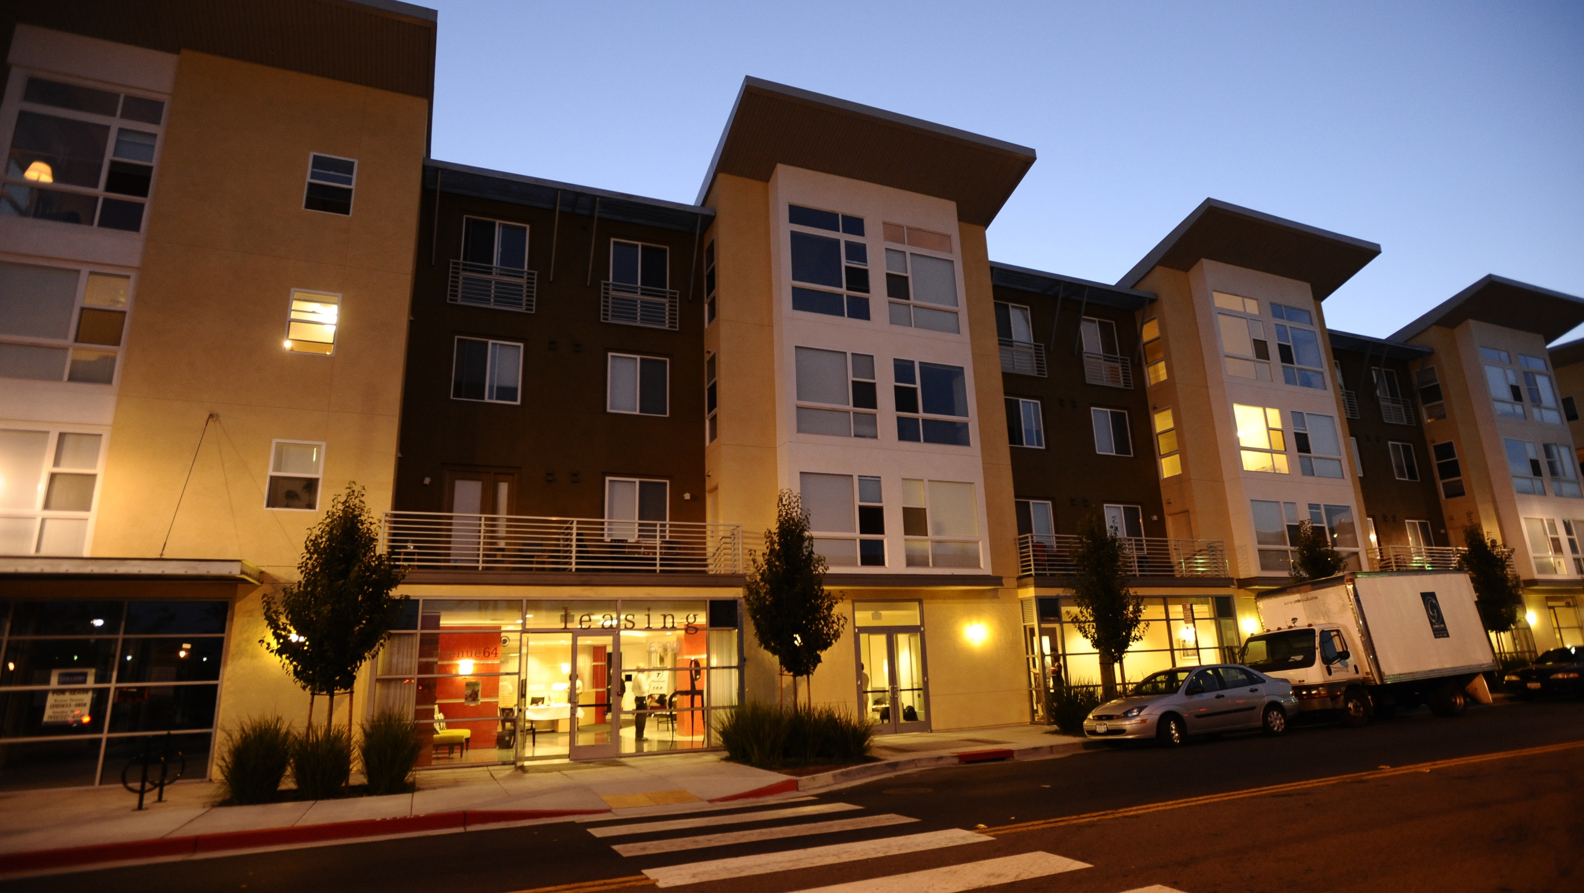


Thank You
Daniel Saver
MTC Deputy Executive Director, Housing & Energy
dsaver@bayareametro.gov

